Slide 1
Data Science Trends

Slide 2
Overview
Data
2017-2021 Kaggle Survey
Kaggle
Online Community of data science practitioners
Purpose
Understand more about the trends and happenings within data science

Slide 3
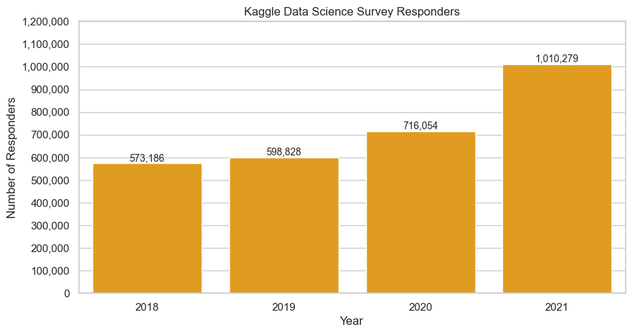
Data Science Practitioners
Notes:
Rapid increase in data science practitioners

Slide 4
Data Science Practitioners
Rapid Increase from 2019 in number of people learning/doing data science
Increase may be overstated
“As we go back in time, the questions lose their completeness more and more”
2017 data not available
Incompleteness of data

Slide 5
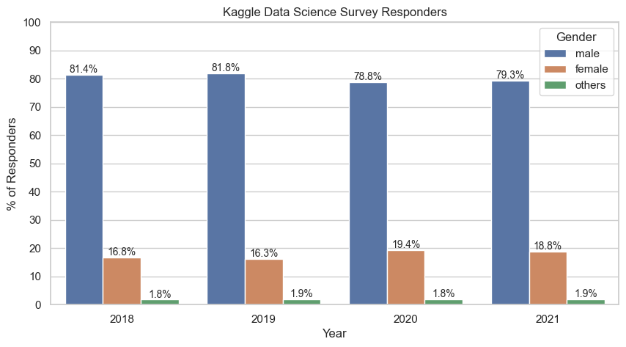
Gender

Slide 6
Gender
Males ~ x4 females
Ratio remains constant over the years

Slide 7
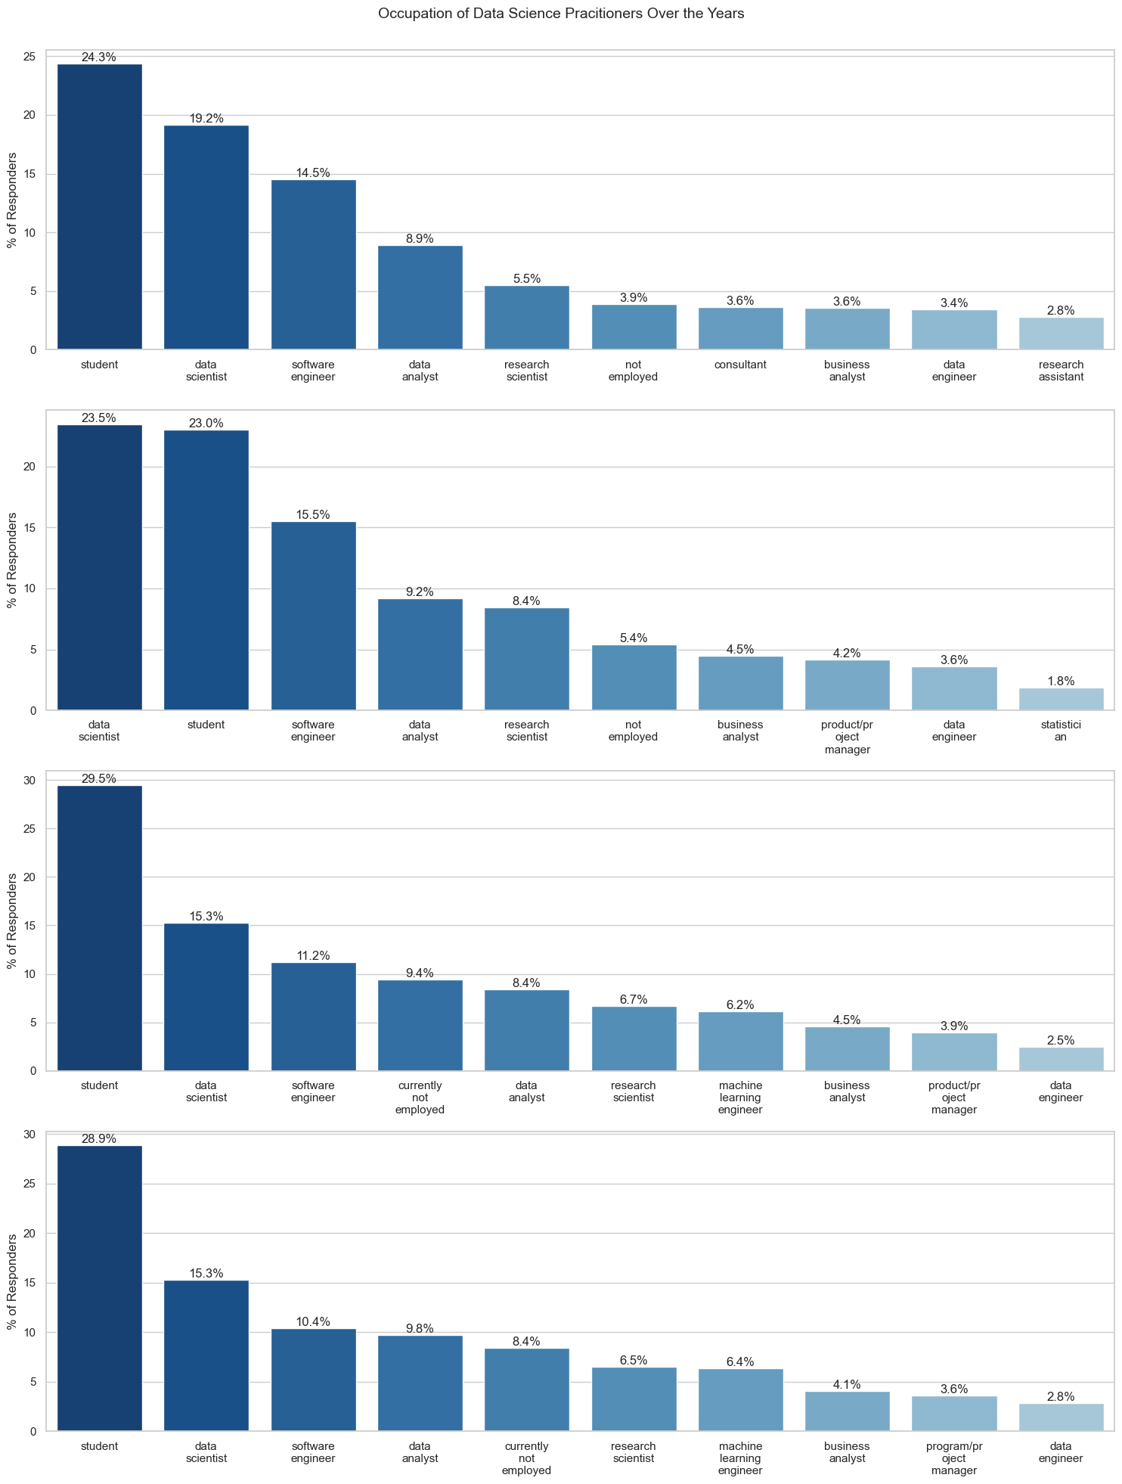
Occupation - 2018
Mostly technology related occupations and research

Slide 8
Occupation - 2019
New role, Product/Project Managers, emerged in top 10 occupations

Slide 9
Occupation - 2020
New role, Machine Learning Engineering, emerged in top 10 occupations

Slide 10
Occupation - 2021
New role, Machine Learning Engineering, stays in top 10 occupations

Slide 11
Occupation
Top occupations learning data science
Students, Data Scientist, Software Engineers, Data Analyst, Unemployed
New emerging roles signifies a change in the way data science is used in industry
More development of data science software,
More specialised roles
Increasing need to have some understanding of data science

Slide 12
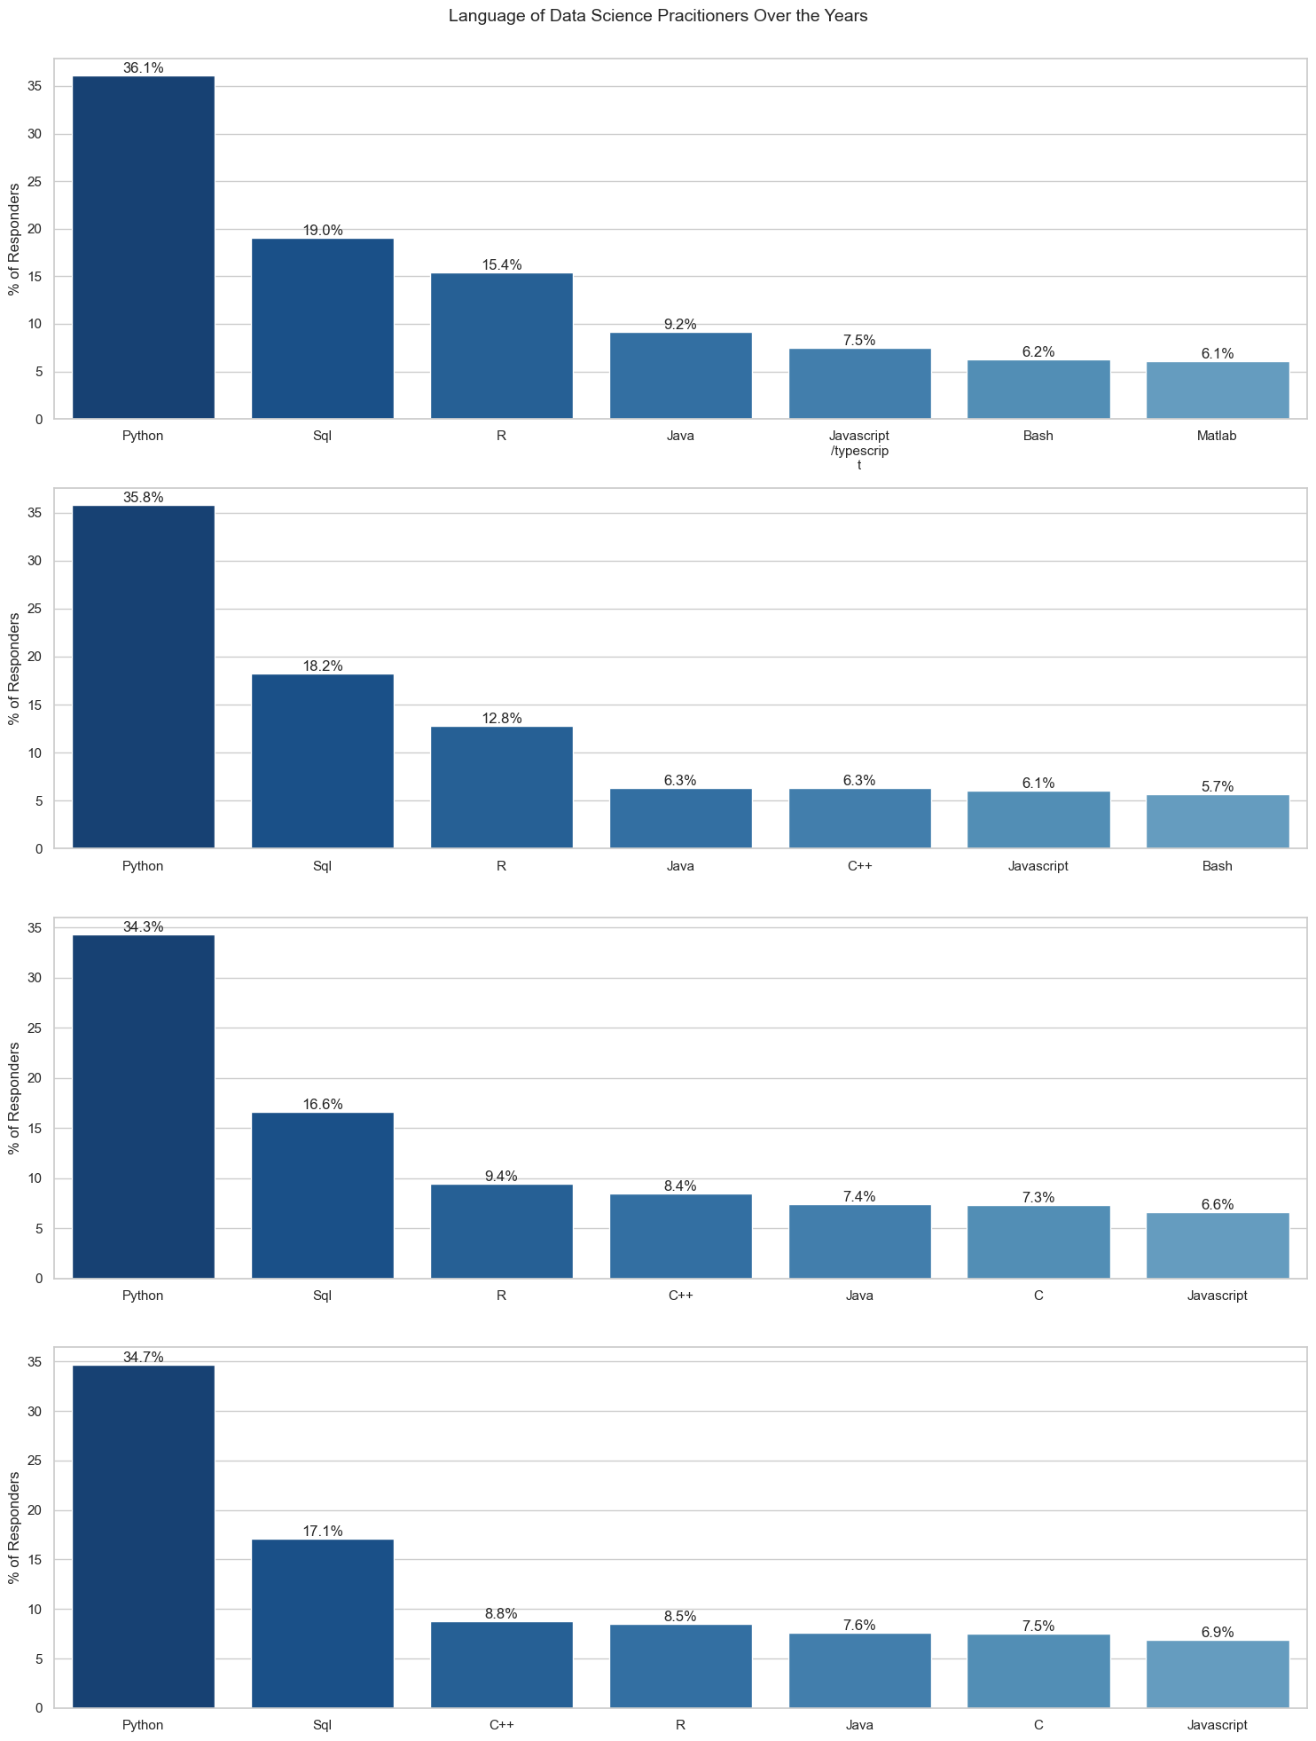
Programming Language - 2018
Top: Python, SQL, R

Slide 13
Programming Language - 2019
Top: Python, SQL, R
Rising: C, C++

Slide 14
Programming Language - 2020
Top: Python, SQL
Rising: C, C++

Slide 15
Programming Language - 2021
Top: Python, SQL
Rising: C++

Slide 16
Programming Language
Python, SQL remains the top language used by practitioners
C++, then C are rising contenders
Much faster than Python

Slide 17
Algorithms - 2018
Absence of data
2 possible reasons
Incomplete data as mentioned above
Less knowledge of a variety of data science methodologies

Slide 18
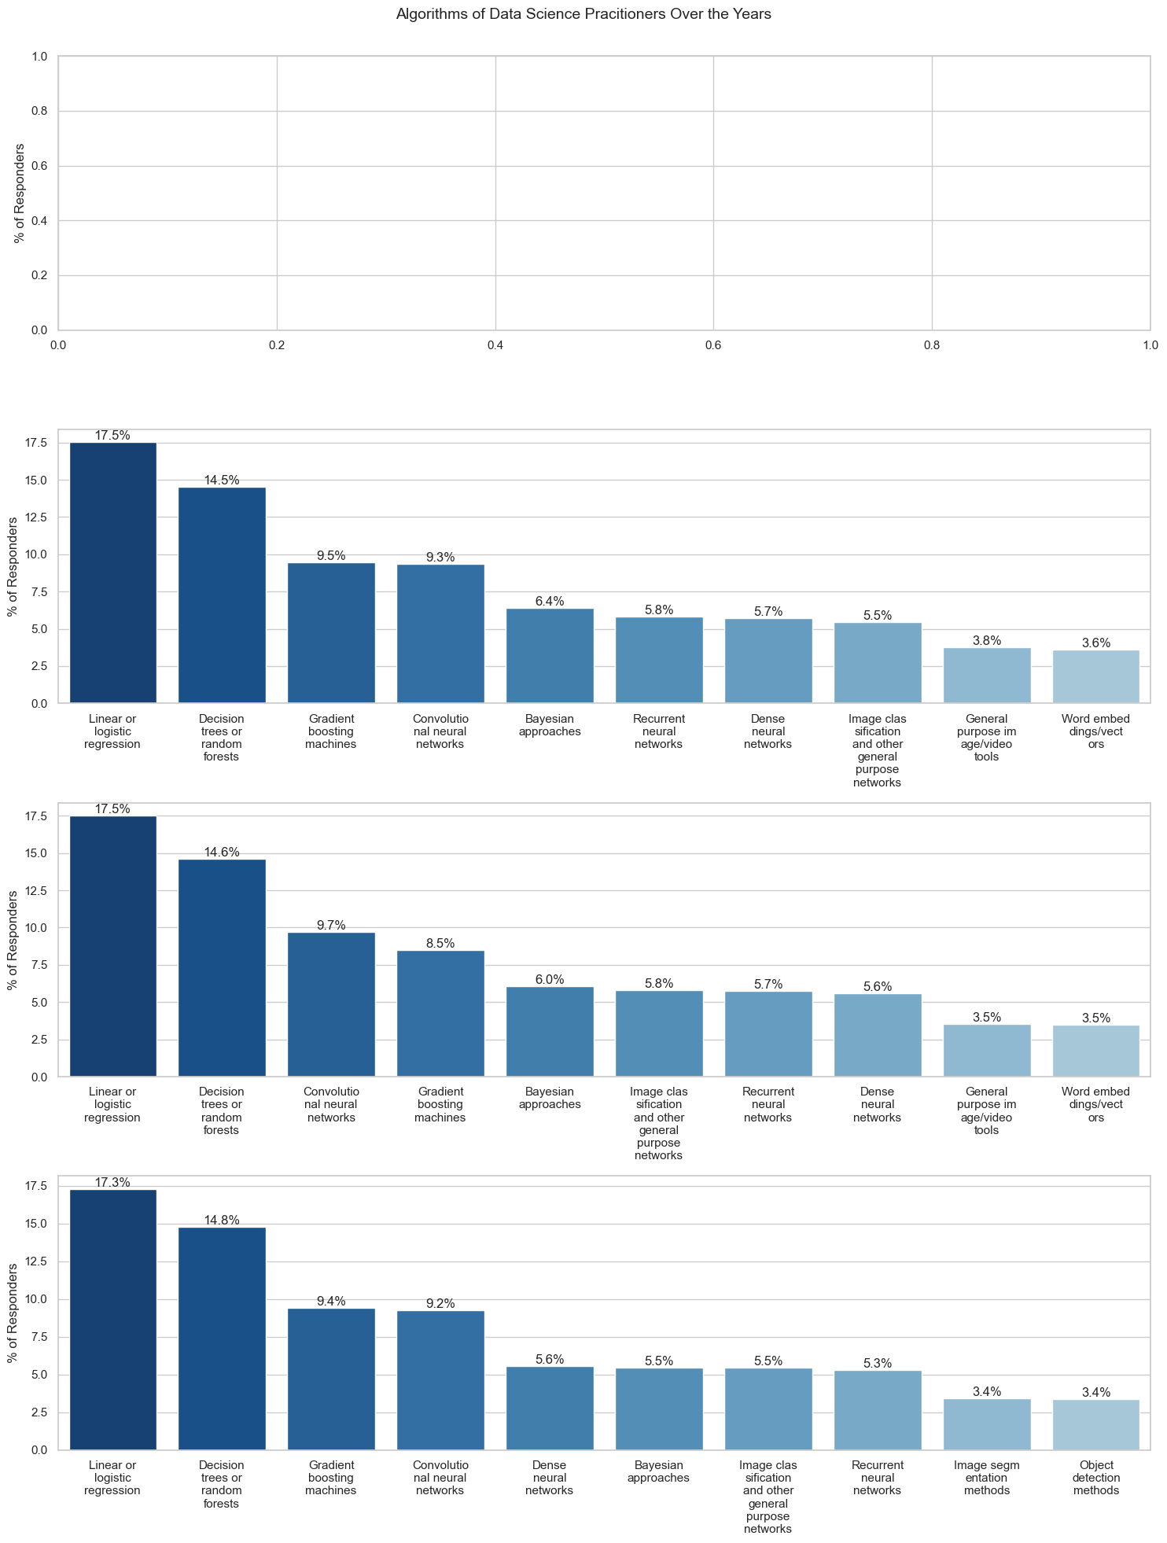
Algorithms - 2019
Machine Learning methods most widely used
Vanilla deep learning methods are the next most popular

Slide 19
Algorithms - 2020

Slide 20
Algorithms - 2021
New Algorithms, Image Segmentation, Object Detection, emerging

Slide 21
Algorithms
Data Science Methodologies did not change much from 2019 - 2020
Increasing interest in Computer Vision in 2021
More tools and proper data, especially open source, widely available for people to train and play around with the latest computer vision methods

Slide 22
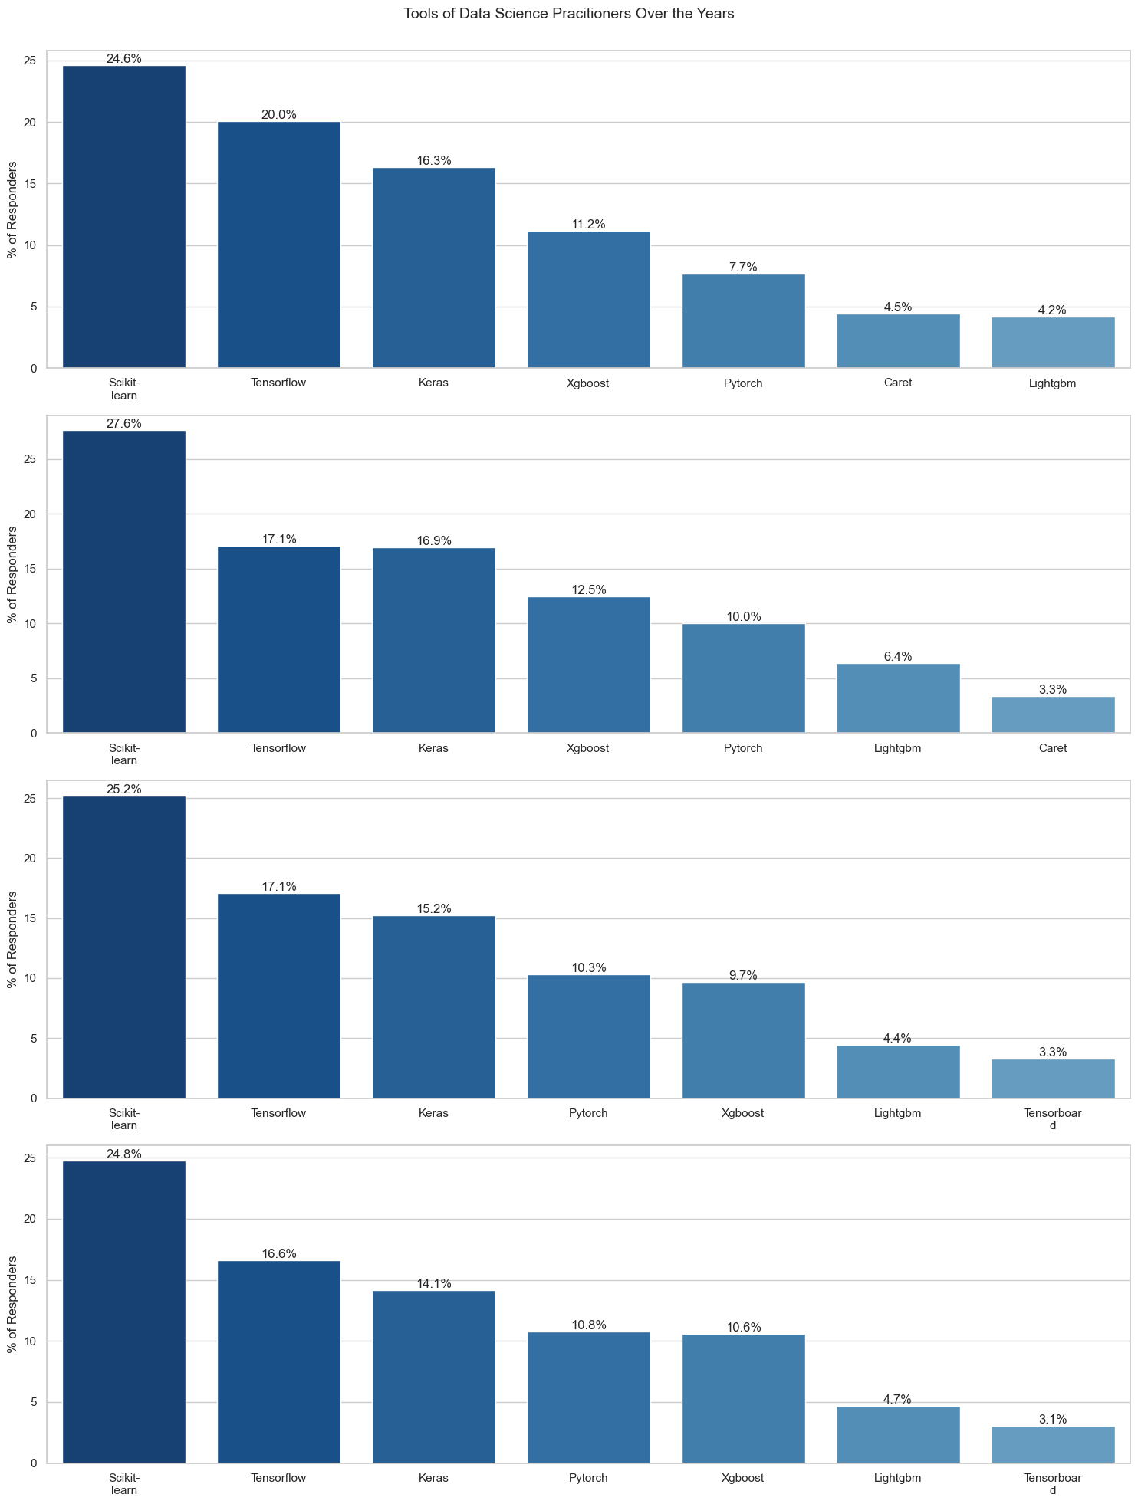
Machine Learning Tools - 2018
Most of the tools are available in python

Slide 23
Machine Learning Tools - 2019
Lightgbm increasing in popularity

Slide 24
Machine Learning Tools - 2020
New emerging tool, Tensorboard, mostly used for tracking and monitoring of training and experimentation
Pytorch gaining popularity

Slide 25
Machine Learning Tools - 2021

Slide 26
Machine Learning Tools
Increasing focus in tracking and monitoring of experimentation
Inline with previous trend of new Machine Learning Engineer role
Increasing popularity in Pytorch

Slide 27
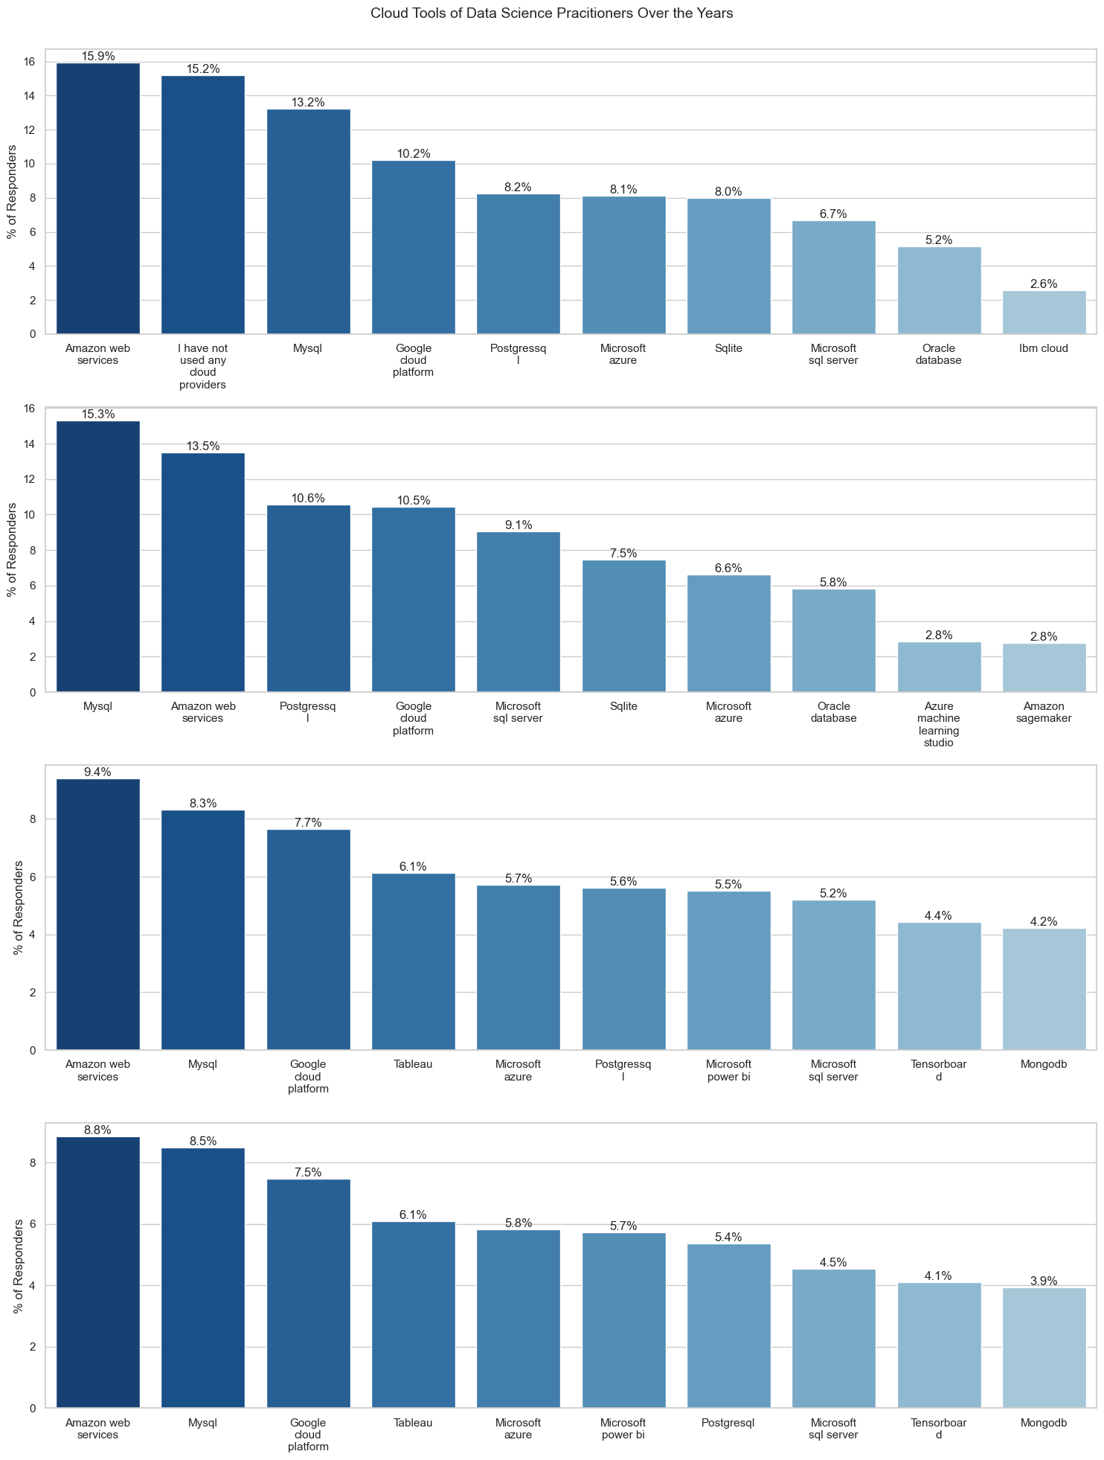
Cloud/Big Data Tools
High percentage of users without any cloud providers
Mostly concentrated on a few tools

Slide 28
Cloud/Big Data Tools
Increase in cloud provider usage
“No cloud provider” dropped from top 10 cloud/big data tools

Slide 29
Cloud/Big Data Tools
Variety of tools increasingly being used
Tableau, Tensorboard, MongoDB
Less emphasis on a few tools

Slide 30
Cloud/Big Data Tools

Slide 31
Cloud/Big Data Tools
Increase use in variety of cloud platforms
Data and Machine Learning seems to be used more efficiently in industries
More BI tools, more cloud platforms being used

Slide 32
Conclusion
More significant changes mostly occur during 2019 - 2020
Python, SQL stills has a stronghold in data science. Faster languages like C++, C gaining traction
Machine Learning is the most widely used. Deep Learning technologies gaining traction with more tools and open source.
Some focus seems to be diverting to the efficient usage of data science to aid businesses

Slide 33
Next Steps
Gather data for 2022
Deeper analysis on data science in different industry and countries

